Slide 1
Storm Water Runoff
Civil Engineering and Architecture
© 2010 Project Lead The Way, Inc.
Notes:
Civil Engineering and Architecture
Unit 2 – Lesson 2.3 – Residential Design
Project Lead the Way, Inc.
Copyright 2010
Storm Water Runoff

Slide 2
TABLE OF CONTENTS
Where Does Storm Water Go?
Site Development
Watershed Characteristics
Storm Water Management
The Rational Method
Storm Characteristics
Example
Storm Water Management Plan
Notes:
Civil Engineering and Architecture
Unit 2 – Lesson 2.3 – Residential Design
Project Lead the Way, Inc.
Copyright 2010
Storm Water Runoff

Slide 3
Where Does Storm Water Go?
Absorbed by the ground/vegetation
Runoff
  Waterway
  Street
  Neighbor
Detained on site
  Detention/retention pond
  Underground storage
Notes:
Civil Engineering and Architecture
Unit 2 – Lesson 2.3 – Residential Design
Project Lead the Way, Inc.
Copyright 2010
Storm Water Runoff

Slide 4
Site Development
Includes improvements or changes to the site
  Buildings
  Pavement
  Landscaping
  Grading
Typically, development increases runoff and decreases absorption of storm water
Notes:
Civil Engineering and Architecture
Unit 2 – Lesson 2.3 – Residential Design
Project Lead the Way, Inc.
Copyright 2010
Storm Water Runoff

Slide 5
Storm Water Management
Regulations have evolved in order to
  Protect the environment
    Water quality
    Sedimentation (grading and erosion control)
  Protect property
    Reduce site runoff
  Reduce impact on storm drainage systems
Notes:
Civil Engineering and Architecture
Unit 2 – Lesson 2.3 – Residential Design
Project Lead the Way, Inc.
Copyright 2010
Storm Water Runoff

Slide 6
Watershed Characteristics Affecting Runoff
Rainfall intensity
Soil type
Slope/topography
Soil condition (compactness)
Vegetation
Notes:
Civil Engineering and Architecture
Unit 2 – Lesson 2.3 – Residential Design
Project Lead the Way, Inc.
Copyright 2010
Storm Water Runoff

Slide 7
Storm Water Management
Many regulations dictate that the post-development runoff not exceed the pre-development runoff.
To calculate the impact of development on storm water runoff, we must calculate the pre-development storm runoff and the post-development storm runoff.
In general, the change in runoff (difference) must be retained/detained onsite such that the additional runoff is not routed to the existing storm water system.
STORM WATER MANAGEMENT PLAN
Notes:
Civil Engineering and Architecture
Unit 2 – Lesson 2.3 – Residential Design
Project Lead the Way, Inc.
Copyright 2010
Storm Water Runoff

Slide 8
The Rational Method
The Rational Formula
  Q = C i A
  Q = Peak runoff rate (cubic feet/sec)
  i = Rainfall intensity (inches/hour)
  A = Area in acres
  C = Runoff coefficient (dependent on surface type)
Notes:
There are many methods to calculate the flow of storm water. We will use the Rational Method because it is one of the simpler methods.
Note that when you analyze the units, Q will be calculated in acres-inches/hour. However, Q is recorded in cubic feet per second. The units do not cancel.
The runoff coefficient is based on empirical data, that is, it was determined by experimentation and observations (not based on theory or logic) and will therefore account for the discrepancy in units. However, the conversion factor from acre-inches/hour to cubic feet per second is 1.008 (very close to 1). So, you would get very nearly the same answer using the required units as you would if you used units of ft/sec for intensity and square feet for area – which would result in the cubic feet per second peak runoff.
As a result, the coefficient can be described as the proportion of rain fall that is shed from a surface. Therefore, a coefficient of .95 indicates that about 95% of the rainfall will runoff of the surface.
Civil Engineering and Architecture
Unit 2 – Lesson 2.3 – Residential Design
Project Lead the Way, Inc.
Copyright 2010
Storm Water Runoff

Slide 9
The Rational Method
The Rational Formula (with recurrence adjustment)
  Q = C_{f} C i A
    Q = Peak runoff rate (cubic ft/sec)
    C_{f} = Runoff coefficient adjustment factor
    C = Runoff coefficient (dependent on type of surface)
    i = Storm intensity (in./hour)
    A = Area in acres
Notes:
A variation of the Rational Formula, that takes into account the severity of a storm, can also be used. As the return period (also called the recurrence interval) increases, the storms become more severe – more rain falls in a shorter amount of time. Because the ground and other surfaces can only absorb a certain amount of water and may become saturated in a shorter amount of time, the percentage of the water that runs off is greater in a more severe storm. The basic rational formula applies to return periods of 1, 5, and 10 years. Storms with a greater return period (e.g., 25, 50, and 100 year storms) will result in a greater storm water runoff than the basic formula will predict. The adjustment factor corrects for this increase. We will use this variation of the Rational Formula that includes the recurrence adjustment.
Civil Engineering and Architecture
Unit 2 – Lesson 2.3 – Residential Design
Project Lead the Way, Inc.
Copyright 2010
Storm Water Runoff

Slide 10
The Rational Method
The Rational Formula (with recurrence adjustment)
  Q = C_{f} C i A
Return Period | C_{f}
1, 2, 5, 10 | 1.0
25 | 1.1
50 | 1.2
100 | 1.25
Notes:
Notice that the greater the return period, the greater the adjustment factor.
Civil Engineering and Architecture
Unit 2 – Lesson 2.3 – Residential Design
Project Lead the Way, Inc.
Copyright 2010
Storm Water Runoff

Slide 11
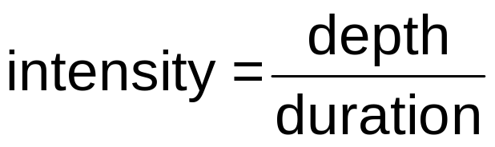
Storm Characteristics
Duration (minutes or hours) during which rain falls in a single storm
Depth (inches) of rainfall resulting from storm
Intensity (inches per hour)
Notes:
The amount of rainfall associated with a single storm can be described by three characteristics: duration, depth, and intensity.
Civil Engineering and Architecture
Unit 2 – Lesson 2.3 – Residential Design
Project Lead the Way, Inc.
Copyright 2010
Storm Water Runoff

Slide 12
Design Storm
Storm magnitude for which storm water management facilities are designed
Dictated by local regulations
Described by return period and duration
Return period – Average length of time between storms of a given duration and depth
  100 year storm has a 1 percent chance of occurring in any given year
  10 year storm has a 10 percent chance of occurring in any given year
Notes:
You may have heard a particular event referred to as a 40 year storm or a 100 year hurricane. The return period of 40 years or 100 years does not mean that another storm of that intensity will not occur in that return period. It simply indicates the chances of a storm of that intensity occurring in any given year.
Civil Engineering and Architecture
Unit 2 – Lesson 2.3 – Residential Design
Project Lead the Way, Inc.
Copyright 2010
Storm Water Runoff

Slide 13
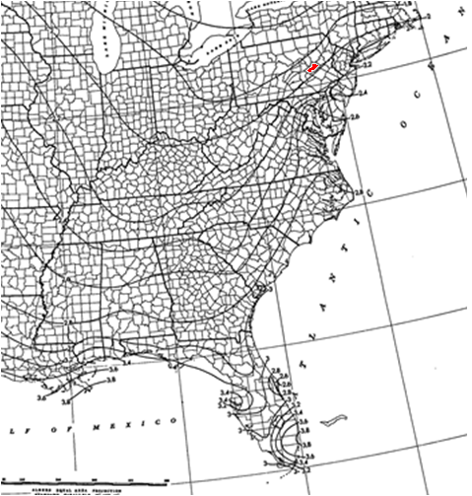
Rainfall Intensity
Rainfall (storm) intensity for a given design storm can be found from maps, tables, or charts.
NOAA Tech. Paper No. 40
Notes:
Rainfall intensity (also called storm intensity or precipitation intensity) data can be obtained from a variety of sources (e.g., maps, tables, and charts). The National Oceanic and Atmospheric Administration provides access to this storm data.
This map shows a 10 year, 1 hour rainfall for parts of the United States including Gordon, PA (shown in red). Although the numbers indicating the intensity in inches per hour are small, the intensity for Gordon is about 1.8 inches per hour.
Civil Engineering and Architecture
Unit 2 – Lesson 2.3 – Residential Design
Project Lead the Way, Inc.
Copyright 2010
Storm Water Runoff

Slide 14
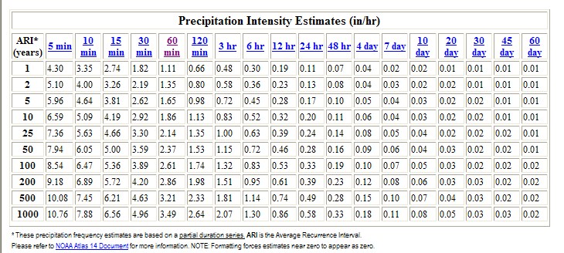
Rainfall Intensity
Intensity Chart for Gordon, PA
http://hdsc.nws.noaa.gov/hdsc/pfds/index.html
Notes:
Another method to display rainfall intensity is to use a chart. This Precipitation Intensity Chart shows the rainfall intensity to be 1.86 in./hr for a 10 year, 1 hour rainfall in Gordon, PA.
Civil Engineering and Architecture
Unit 2 – Lesson 2.3 – Residential Design
Project Lead the Way, Inc.
Copyright 2010
Storm Water Runoff

Slide 15
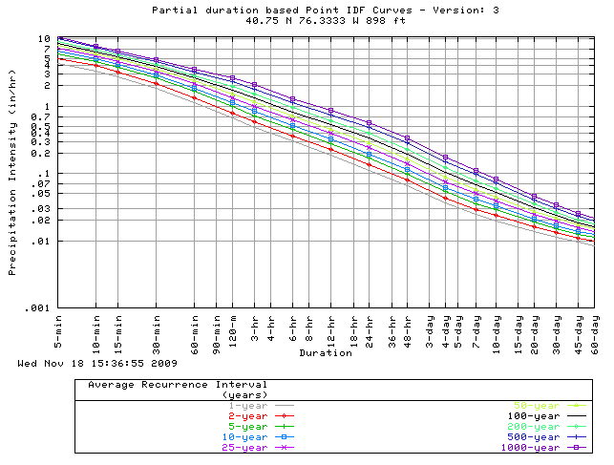
Rainfall Intensity
Intensity-Duration-Frequency (IDF) chart for Gordon, PA
http://hdsc.nws.noaa.gov/hdsc/pfds/index.html
Notes:
An IDF chart is simply the graphical form of the intensity chart shown on the previous slide. This IDF chart allows the user to find the rainfall intensity for a wide range of return frequencies and durations. Note that the intensity for a 10 year (shown as the light blue line), 1 hour storm is 1.8 inches per hour in Gordon, PA (the same as that obtained from the chart).
Civil Engineering and Architecture
Unit 2 – Lesson 2.3 – Residential Design
Project Lead the Way, Inc.
Copyright 2010
Storm Water Runoff

Slide 16
Example
Suppose a developer purchased a 3-acre farm in Nashville, Tennessee. A 30,000 sq ft asphalt parking lot will be placed on the plot. Local regulations require that post-development runoff be limited to pre-development runoff for a 25 year, 1 hour rainfall.
Find the change in peak runoff (i.e., find the difference in the pre-development peak runoff and post-development peak runoff).
Notes:
Civil Engineering and Architecture
Unit 2 – Lesson 2.3 – Residential Design
Project Lead the Way, Inc.
Copyright 2010
Storm Water Runoff

Slide 17
Pre-Development Analysis
Using the Rational Formula (with recurrence adjustment)
  Q = C_{f}C i A
A = Area of the property in acres
A = 3 acres
Notes:
The area was provided in the problem.
Civil Engineering and Architecture
Unit 2 – Lesson 2.3 – Residential Design
Project Lead the Way, Inc.
Copyright 2010
Storm Water Runoff

Slide 18
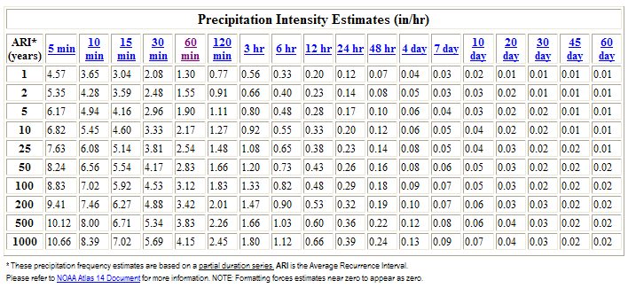
Pre-Development Analysis
i = Rainfall intensity
Use the Weather Bureau Intensity chart for Nashville, TN (http://hdsc.nws.noaa.gov/hdsc/pfds/index.html)
i = 2.54 in./hr
Notes:
Using the intensity table (or map or IDF curve), you can find that the rainfall intensity in Nashville, Tennessee for a 25 year, 1 hour storm is 2.54 inches per hour.
Civil Engineering and Architecture
Unit 2 – Lesson 2.3 – Residential Design
Project Lead the Way, Inc.
Copyright 2010
Storm Water Runoff

Slide 19
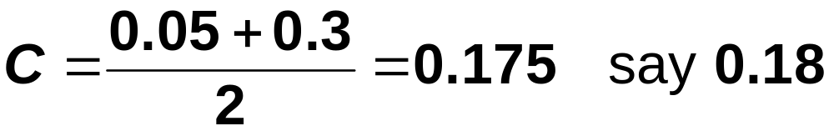
Pre-Development Analysis
C = Runoff Coefficient
Pre-development: Farmland
From Rational Method Runoff Coefficients table
C = 0.05 – 0.3
Use an average
Notes:
Based on the Rational Method Runoff Coefficients table, the coefficient for farmland is 0.05 to 0.3. In order to get a more precise estimate, more information would be needed about the site (e.g., slope, soil, vegetation, etc.). Without more information, assume an average value.
Civil Engineering and Architecture
Unit 2 – Lesson 2.3 – Residential Design
Project Lead the Way, Inc.
Copyright 2010
Storm Water Runoff

Slide 20
Pre-Development Analysis
C_{f} = Runoff Coefficient adjustment factor
= 1.0 for a 10 year storm.
Return Period | C_{f}
1, 2, 5, 10 | 1.0
25 | 1.1
50 | 1.2
100 | 1.25
Notes:
Using the table, a 25 year storm has a runoff coefficient adjustment factor of 1.1.
Civil Engineering and Architecture
Unit 2 – Lesson 2.3 – Residential Design
Project Lead the Way, Inc.
Copyright 2010
Storm Water Runoff

Slide 21
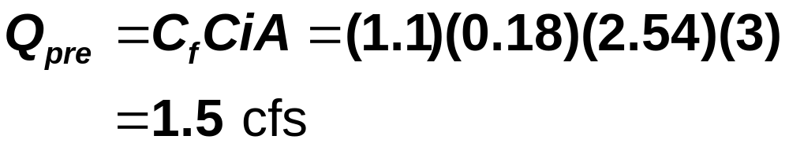
Pre-Development Analysis
Notes:
Civil Engineering and Architecture
Unit 2 – Lesson 2.3 – Residential Design
Project Lead the Way, Inc.
Copyright 2010
Storm Water Runoff

Slide 22
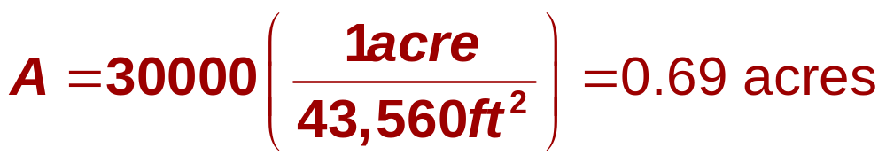

Post-Development Analysis
A = Area
Parking
Farmland
i = Rainfall intensity
Same as pre-development intensity = 2.54 in./hr

Slide 23
Post-Development Analysis
C = Runoff Coefficient
Farmland: Use C = 0.18
Asphalt pavement: Use C = 0.95
Notes:
Use the same runoff coefficient used for farmland in the pre-development analysis.
Calculate a composite runoff coefficient which provides and overall runoff coefficient which takes into account all of the different surfaces included on the lot.

Slide 24
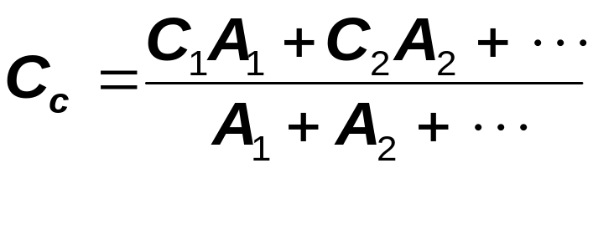
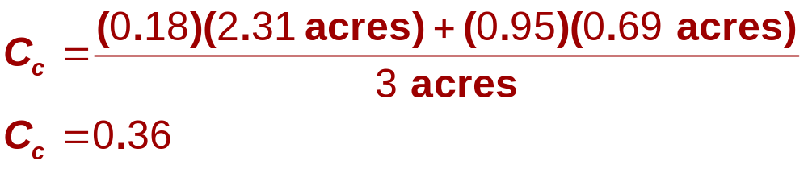
Post-Development Analysis
Composite Runoff coefficient, C_{c}
Notes:
Calculate a composite runoff coefficient which provides and overall runoff coefficient which takes into account all of the different surfaces included on the lot.

Slide 25
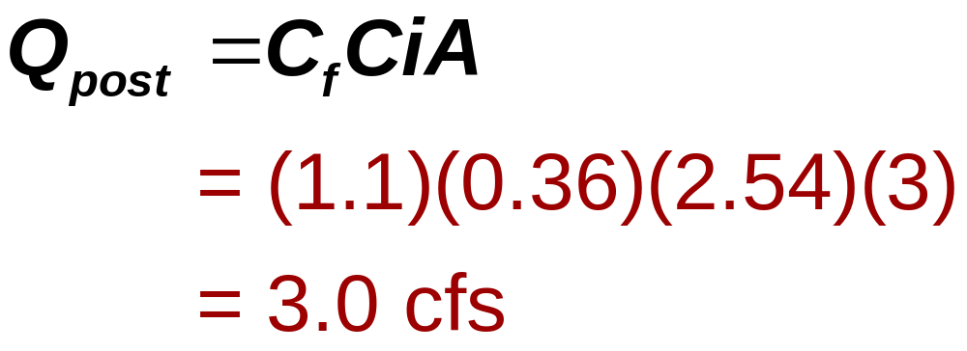
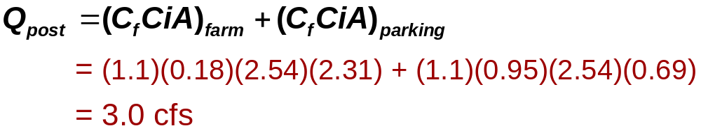
Post-Development Analysis
ALTERNATE METHOD
Notes:
The post development runoff flow rate is 3 cfs.
[click] An alternate method of calculating runoff for sites that include more than one type of surface is to calculate the runoff separately for each surface and add them together (as shown). Notice that the resulting flow rate is the same regardless of which method is used.

Slide 26
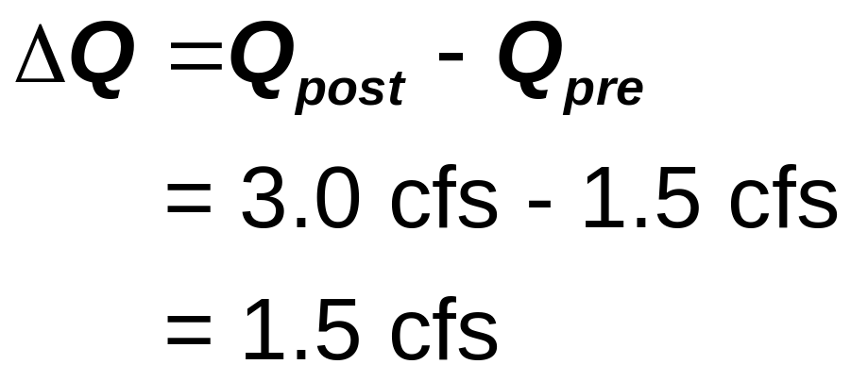
Change in Site Runoff
Calculate the difference
Notes:
The change in runoff due to development is 1.5 cubic feet per second. The post development runoff is twice the predevelopment runoff.

Slide 27
Storm Water Management Plan
The engineer uses this information to create a storm water management plan. This plan would include:
  Release rate not to exceed the peak pre-development Q
  Swales (ditches)
  Storm water pipes
  Storm water management facilities
    Retention/detention ponds
    Bioretention areas
Notes:
Civil Engineering and Architecture
Unit 2 – Lesson 2.3 – Residential Design
Project Lead the Way, Inc.
Copyright 2010
Storm Water Runoff

Slide 28
TABLE OF CONTENTS
Where Does Storm Water Go?
Site Development
Watershed Characteristics
Storm Water Management
The Rational Method
Storm Characteristics
Example
Storm Water Management Plan
Notes:
Civil Engineering and Architecture
Unit 2 – Lesson 2.3 – Residential Design
Project Lead the Way, Inc.
Copyright 2010
Storm Water Runoff

Slide 29
Resources
Weather Bureau, U. S. Department of Commerce. (1961). Rainfall frequency atlas of the United States: Technical paper no. 40. Retrieved Nov. 18, 2009, from http://hdsc.nws.noaa.gov/hdsc/pfds/other/fl_pfds.html.
Notes:
Civil Engineering and Architecture
Unit 2 – Lesson 2.3 – Residential Design
Project Lead the Way, Inc.
Copyright 2010
Storm Water Runoff

